Slide 1
Network Intrusion Detection System

Slide 2
Project Overview
Network Intrusion Predictor – AI Driven, web application to predict the anomalies and attacks in the network.
Walkthrough of the application:
Login by providing user credentials.
The user should enter the defined parameters referring to the traffic input.
User clicks on predict and gets to know about the type of attack.
Technologies:
Python, Keras, Tensorflow, Pickle, React.JS, MongoDB &Node.JS

Slide 3
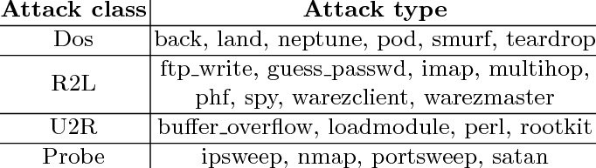
Network Intrusion
A network intrusion refers to any forcible or unauthorized activity on a digital network.
Attacks can broadly classified into four major categories:
1. DOS(Denial of Service)
2. Probe
3. R2L(Remote-to-User)
4. U2R(User-to-Root)
Ref: https://www.ijrte.org/wp-content/uploads/papers/v9i1/A1942059120.pdf

Slide 4
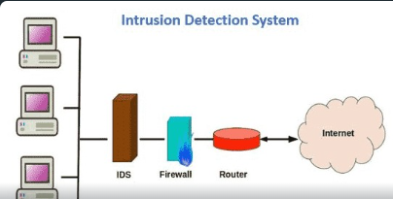
Network Intrusion Detection System
Network intrusion detection systems are placed at a strategic point within the network to examine traffic from all devices on the network.
Once it identifies an attack or senses abnormal behavior, it sends an alert to the user.
Ref: https://www.sciencedirect.com/topics/computer-science/network-based-intrusion-detection- system#:~:text=A%20network%2Dbased%20intrusion%20detection,the%20traffic%20they%20monitor%3B%20Fig

Slide 5
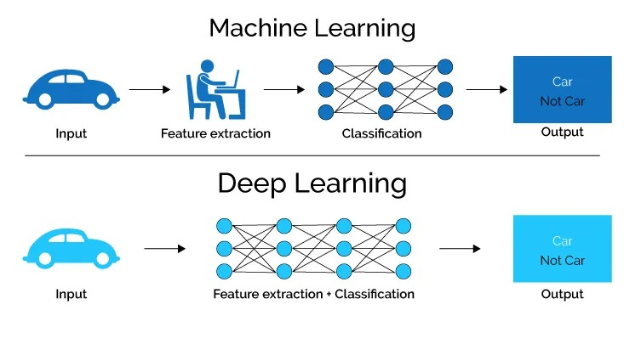
Machine Learning:
Machine Learning is a subset of artificial intelligence
technique which uses statistical methods to enable
machines to improve experience.
Ref: https://www.youtube.com/playlist?list=PLeo1K3hjS3uvCeTYTeyfe0-rN5r8zn9rw
Deep Learning:
Deep learning is a type of machine learning that
imitates the way humans gain certain types of knowledge.
Ref: https://www.youtube.com/playlist?list=PLeo1K3hjS3uu7CxAacxVndI4bE_o3BDtO
Recurrent neural network(RNN):
A recurrent neural network (RNN) is a class of artificial neural networks where connections between nodes can create a cycle, allowing output from some nodes to affect subsequent input to the same nodes.
Ref: https://www.youtube.com/watch?v=Y2wfIKQyd1I&t=632s

Slide 6
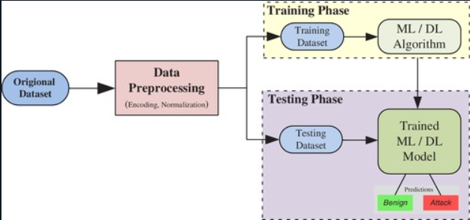
Process Flow Of Network Intrusion Detection System(NIDS)
Dataset used: NSL-KDD
NSL-KDD is a new version data set of the KDD'99 data set.
This is an effective benchmark data set to help researchers compare different intrusion detection methods.
Ref: https://www.unb.ca/cic/datasets/nsl.html
Future Ref: https://onlinelibrary.wiley.com/doi/full/10.1002/ett.4150

Slide 7
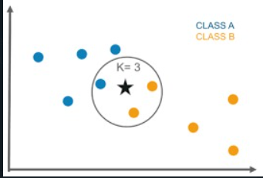
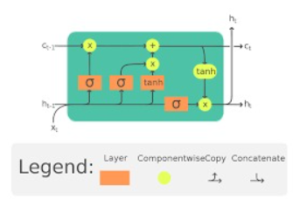
Machine Learning and Deep Learning Models Used
K – Nearest Neighbours Algorithm(KNN) (Machine Learning Model) | Long-Short Term Memory Algorithm(LSTM) (Deep Learning Model)
A k-nearest-neighbor is a data classification algorithm that attempts to determine what group a data point is in by looking at the data points around it. Ref: https://www.youtube.com/watch?v=CQveSaMyEwM | It is special kind of RNN that is capable of learning long term dependencies in data. This is achieved because the recurring module of the model has a combination of four layers interacting with each other. Ref: https://www.youtube.com/watch?v=LfnrRPFhkuY&t=67s

Slide 8
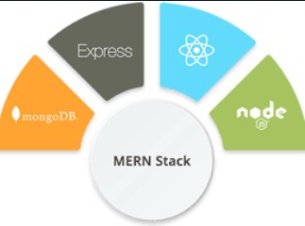
Web application
Web application is built using MERN.
The user enters the hacking parameters in the front end which is designed by using ReactJS.
ExpressJS is used for user authentication.
MongoDB is used for storing the data
NodeJS is served as back end framework

